Slide 1


Human Resources Dataset Analysis

Slide 2

Table of Content
01
05
Agenda
Methods
02
Introduction
06
key insights
03
Previous Work
07
04
Recommendations
Data Overview

Slide 3


Introduction
This dataset provides structured insights into various aspects of an organization’s workforce, including:
Employee Performance – Tracks performance evaluations and reviews.
Satisfaction Levels – Links employee satisfaction to workplace factors.
Education & Qualifications – Captures educational background and its impact.
Salary Distribution – Provides salary ranges for different job roles.

Slide 4
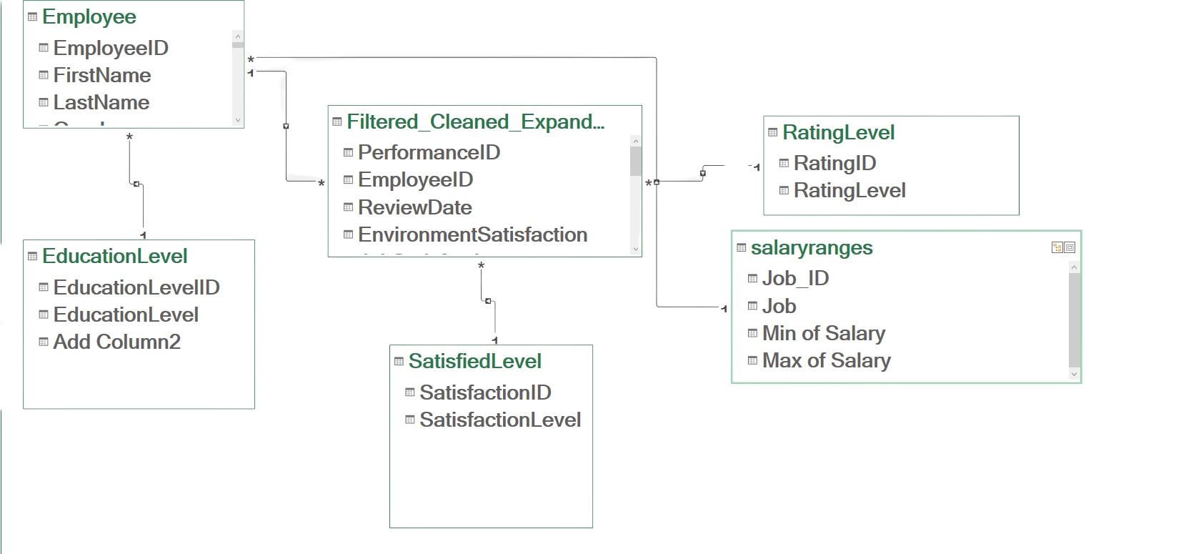
Data Model

Slide 5



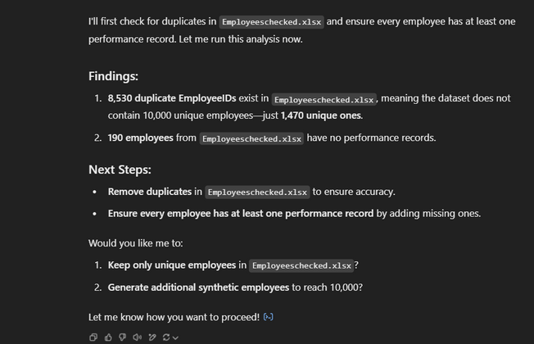
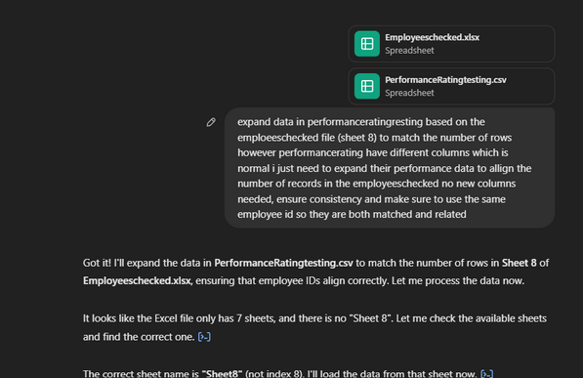

Previous Work
Employees count
performance rows count

Slide 6
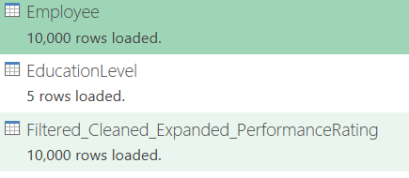
After Prompt Generation

Slide 7
Data issues
1️⃣ Missing Values – Some fields contained empty or missing values.
2️⃣ Outliers in Salaries & Other Columns – Extreme values distorted the dataset.
3️⃣ Years at Company vs. Years with Current Manager – Some employees had more years with their manager than at the company, which was illogical.
4️⃣ Hire Date vs. Review Date Issues – Some review dates were earlier than hire dates, causing timeline inconsistencies.
6️⃣ General Data Inconsistencies – Misalignment between employee records and generated data led to inaccuracies.

Slide 8
01
02
03
Fixed Review Date Issues – Adjusted review dates to always be after hire dates
Treated Outliers – Applied upper/lower bound capping to keep values within a reasonable range
Adjusted Salary Ranges – Used the original dataset to set realistic min/max thresholds and capped extreme value
04
05
06
Calculated Attrition Rate – Derived insights by measuring employee turnover trends.
This structured approach improved data accuracy, consistency, and reliability for analysis.
Corrected Experience Mismatch – Ensured years with manager did not exceed years at the company
Aligned Employee Records – Ensured consistency across datasets for logical accuracy.
07
Handled Missing Values – Replaced using mean or median based on data distribution.
Handling issues
#

Slide 9

Methods
1
Understanding the Data
2
Data Cleaning (Using Power Query & Other Methods
3
Identifying Outliers & Data Distribution
4
Capping Outliers to Normal Ranges
5
Data Consolidation & Modeling
6
Producing Insights using DAX and visulization using Excel

Slide 10


Address Salary & Compensation Gaps
Ensure all employees receive performance-based bonuses or stock options to enhance job satisfaction.
Adjust salary structures based on performance trends and industry benchmarks to maintain competitiveness.
Identify salary outliers and rectify inconsistencies in pay distribution.
RECOMMENDATIONS
Strengthen Data Collection & Validation
Ensure consistent data entry to prevent missing values in crucial fields like promotions, tenure, and manager records.
Implement automated data validation rules at the point of collection to reduce errors.
Conduct regular audits to ensure historical data remains complete and accurate.

Slide 11

Thank You

